Slide 1
Functional Testing
BY : ARVIND SHARMA

Slide 2
Some Observations
It is impossible to completely test any nontrivial module or any system
Theoretical limitations: Halting problem
Practical limitations: Prohibitive in time and cost
Testing can only show the presence of bugs, not their absence.
total number of execution paths?
loop 200 times

Slide 3
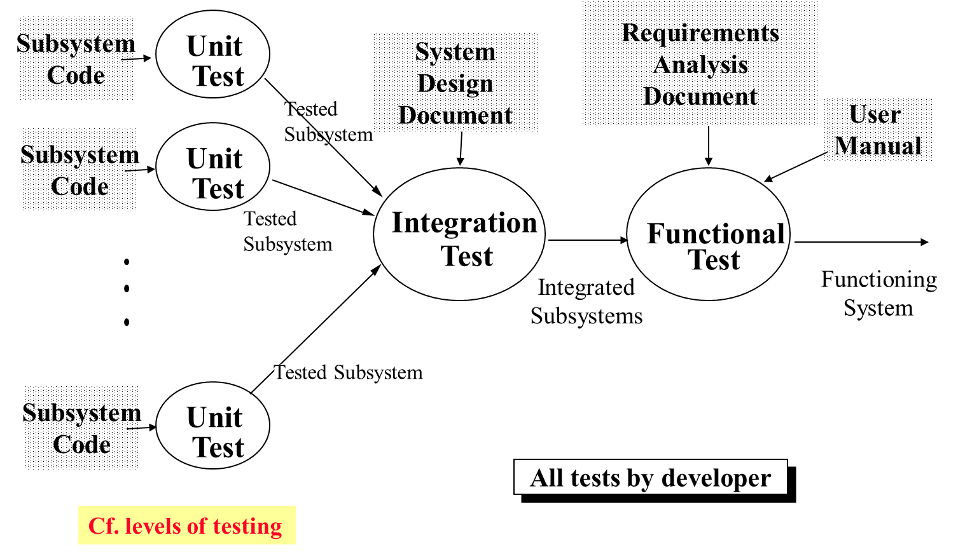
Testing Activities

Slide 4
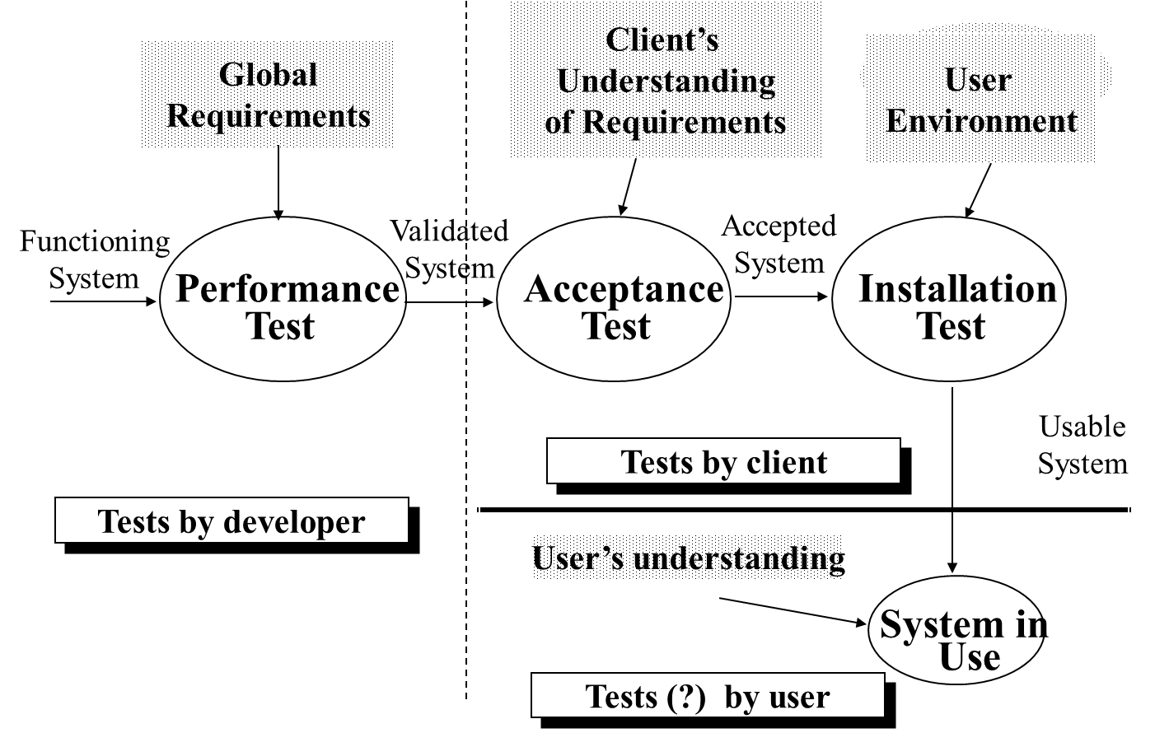
Testing Activities continued

Slide 5
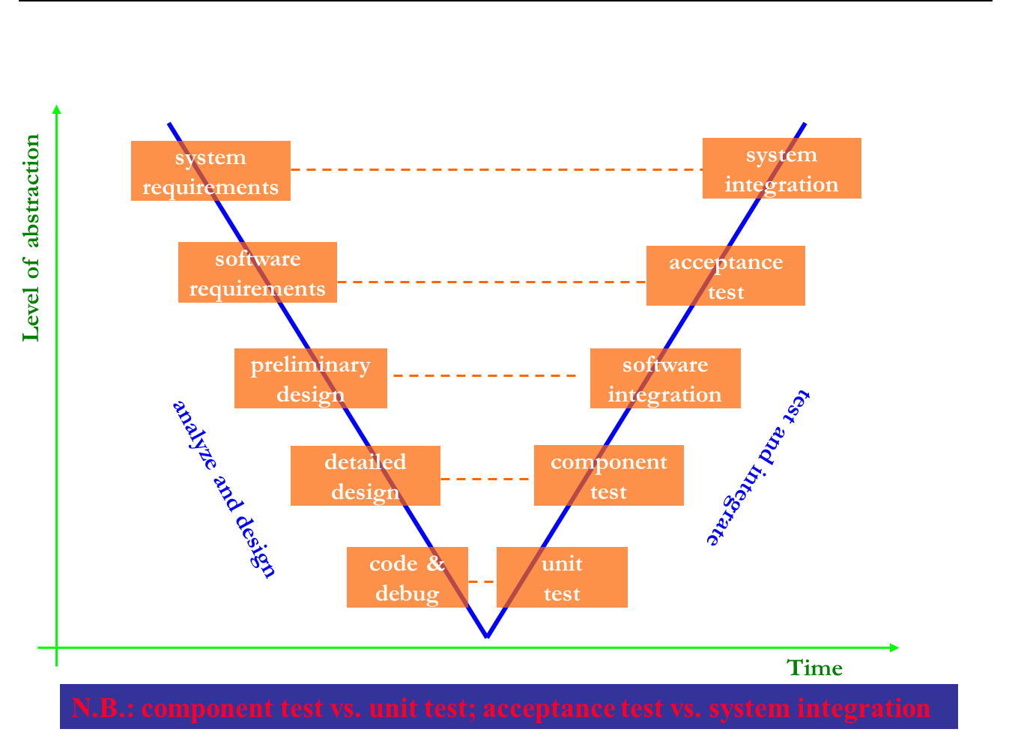
Levels of Testing in V Model

Slide 6
Test Planning
A Test Plan:
covers all types and phases of testing
guides the entire testing process
who, why, when, what
developed as requirements, functional specification, and high-level design are developed
should be done before implementation starts
A test plan includes:
test objectives
schedule and logistics
test strategies
test cases
procedure
data
expected result
procedures for handling problems

Slide 7
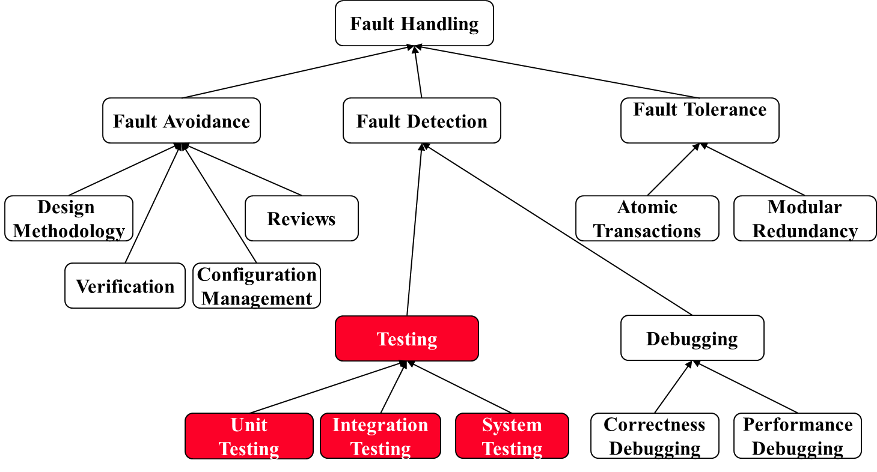
Fault Handling Techniques

Slide 8
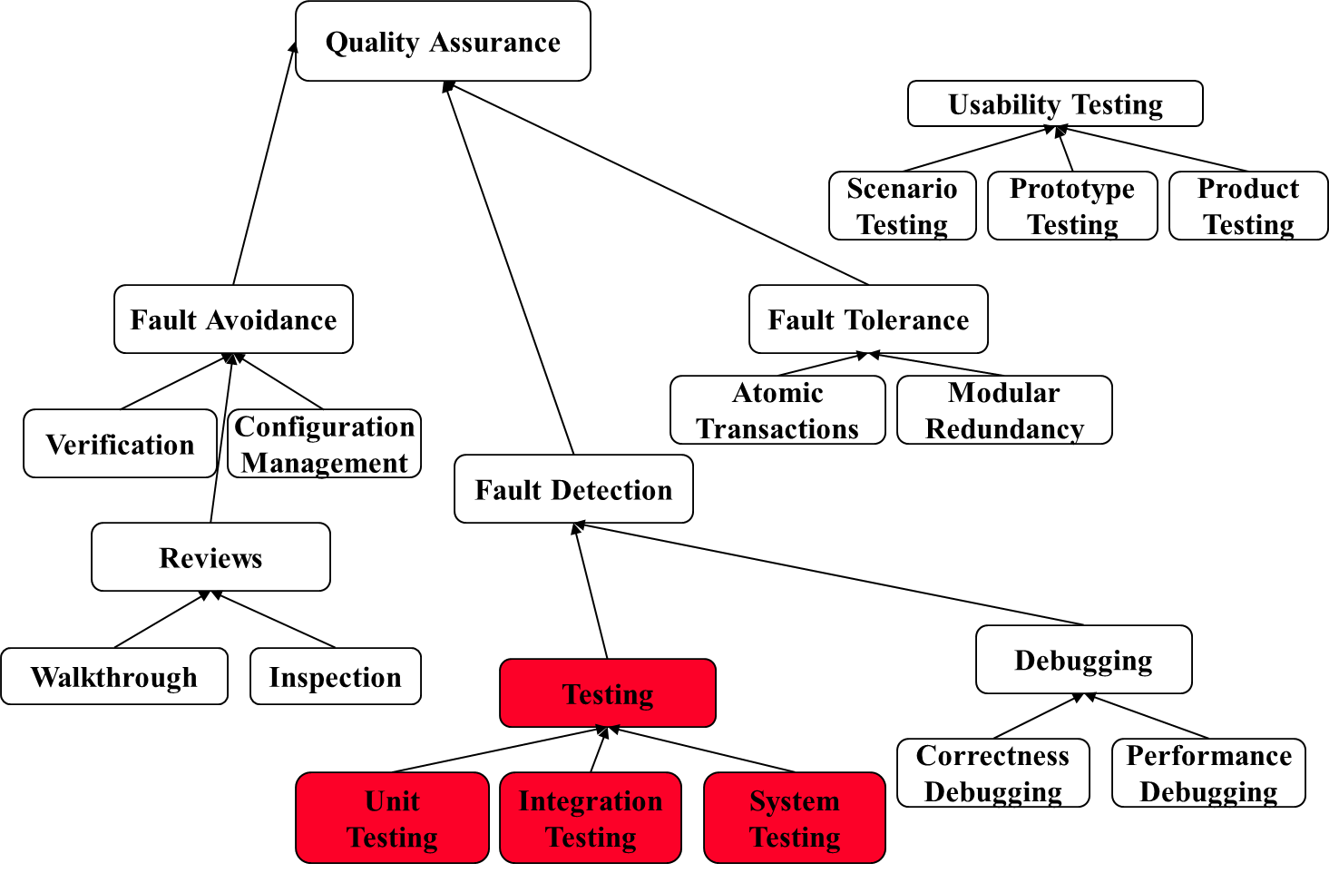
Quality Assurance encompasses Testing

Slide 9
Types of Testing
Unit Testing:
Individual subsystem
Carried out by developers
Goal: Confirm that subsystems is correctly coded and carries out the intended functionality
Integration Testing:
Groups of subsystems (collection of classes) and eventually the entire system
Carried out by developers
Goal: Test the interface among the subsystem

Slide 10
System Testing
System Testing:
The entire system
Carried out by developers
Goal: Determine if the system meets the requirements (functional and global)
Acceptance Testing:
Evaluates the system delivered by developers
Carried out by the client. May involve executing typical transactions on site on a trial basis
Goal: Demonstrate that the system meets customer requirements and is ready to use
Implementation (Coding) and testing go hand in hand

Slide 11
Black-box Testing
Focus: I/O behavior. If for any given input, we can predict the output, then the module passes the test.
Almost always impossible to generate all possible inputs ("test cases")
Goal: Reduce number of test cases by equivalence partitioning:
Divide input conditions into equivalence classes
Choose test cases for each equivalence class. (Example: If an object is supposed to accept a negative number, testing one negative number is enough)

Slide 12
Black-box Testing (Continued)
Selection of equivalence classes (No rules, only guidelines):
Input is valid across range of values. Select test cases from 3 equivalence classes:
Below the range
Within the range
Above the range
Input is valid if it is from a discrete set. Select test cases from 2 equivalence classes:
Valid discrete value
Invalid discrete value

Slide 13
Terminology
Reliability: The measure of success with which the observed behavior of a system confirms to some specification of its behavior.
Failure: Any deviation of the observed behavior from the specified behavior.
Error: The system is in a state such that further processing by the system will lead to a failure.
Fault (Bug): The mechanical or algorithmic cause of an error.
There are many different types of errors and different ways how we can deal with them.

Slide 14
Examples of Faults and Errors
Faults in the Interface specification
Mismatch between what the client needs and what the server offers
Mismatch between requirements and implementation
Algorithmic Faults
Missing initialization
Branching errors (too soon, too late)
Missing test for nil
Mechanical Faults (very hard to find)
Documentation does not match actual conditions or operating procedures
Errors
Stress or overload errors
Capacity or boundary errors
Timing errors
Throughput or performance errors

Slide 15
Dealing with Errors
Verification:
Assumes hypothetical environment that does not match real environment
Proof might be buggy (omits important constraints; simply wrong)
Modular redundancy:
Expensive
Declaring a bug to be a “feature”
Bad practice
Patching
Slows down performance
Testing
Testing is never good enough

Slide 16
Another View on How to Deal with Errors
Error prevention (before the system is released):
Use good programming methodology to reduce complexity
Use version control to prevent inconsistent system
Apply verification to prevent algorithmic bugs
Error detection (while system is running):
Testing: Create failures in a planned way
Debugging: Start with an unplanned failures
Monitoring: Deliver information about state. Find performance bugs
Error recovery (recover from failure once the system is released):
Data base systems (atomic transactions)
Modular redundancy
Recovery blocks

Slide 17
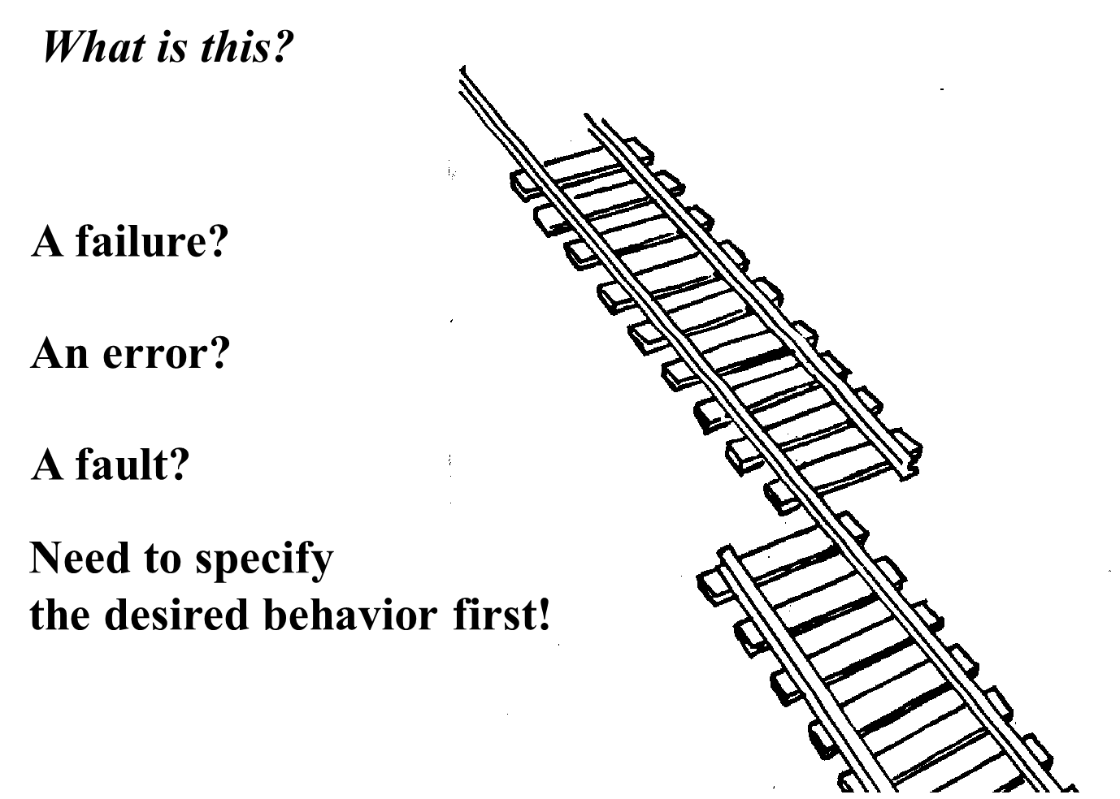

Slide 18
Erroneous State (“Error”)

Slide 19
Algorithmic Fault

Slide 20
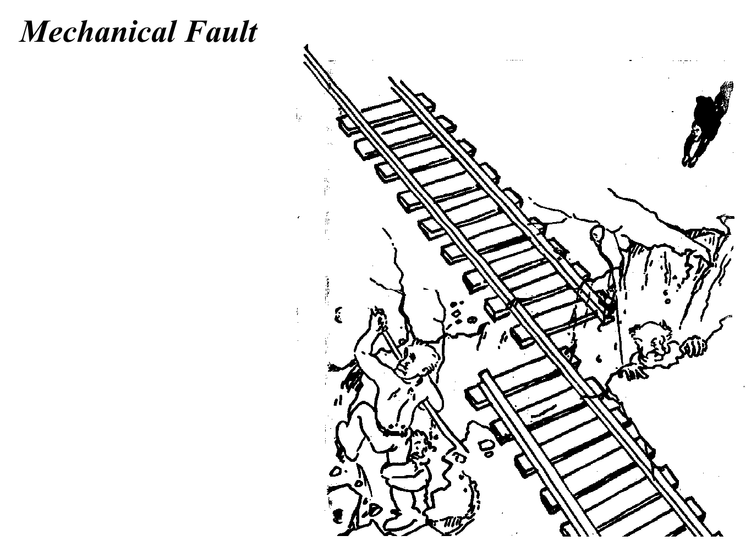

Slide 21
How do we deal with Errors and Faults?

Slide 22
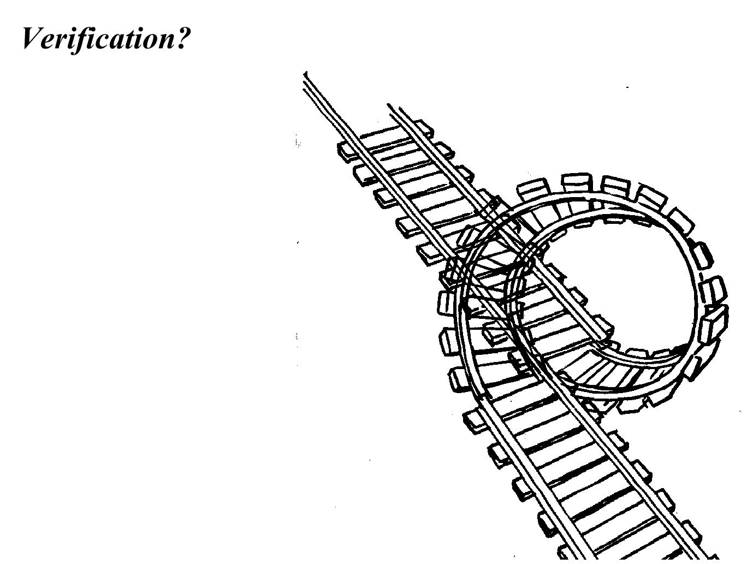

Slide 23
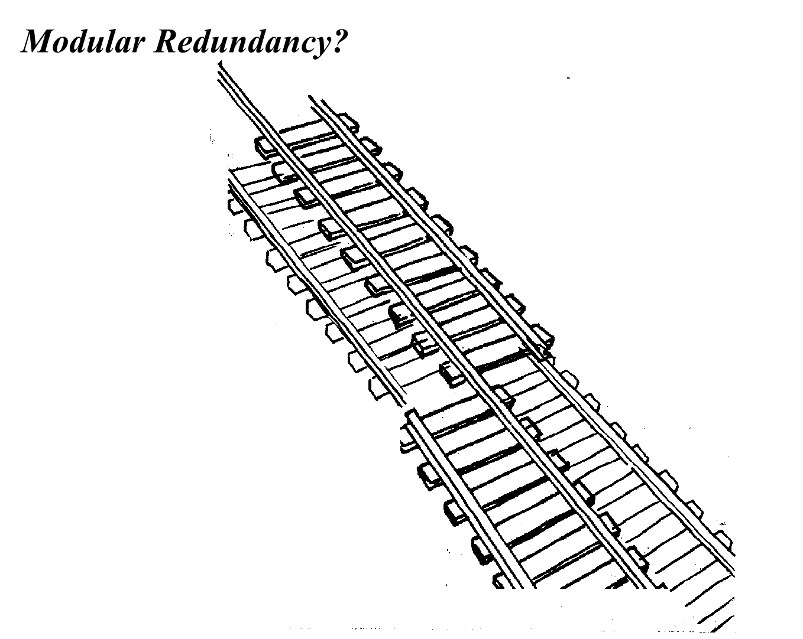

Slide 24
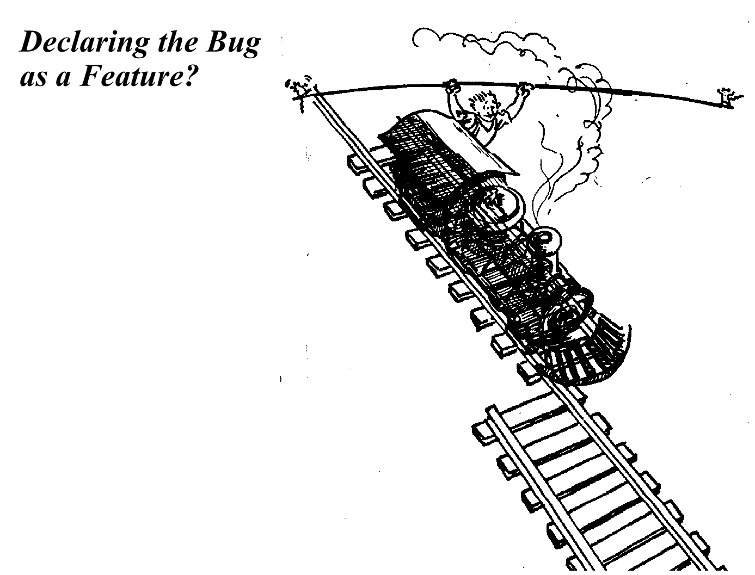

Slide 25
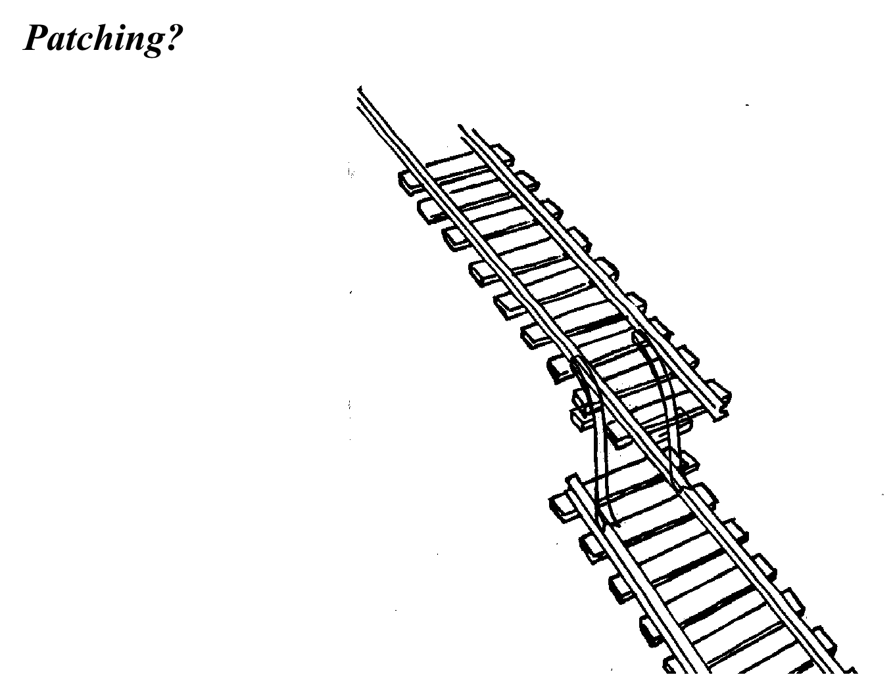

Slide 26
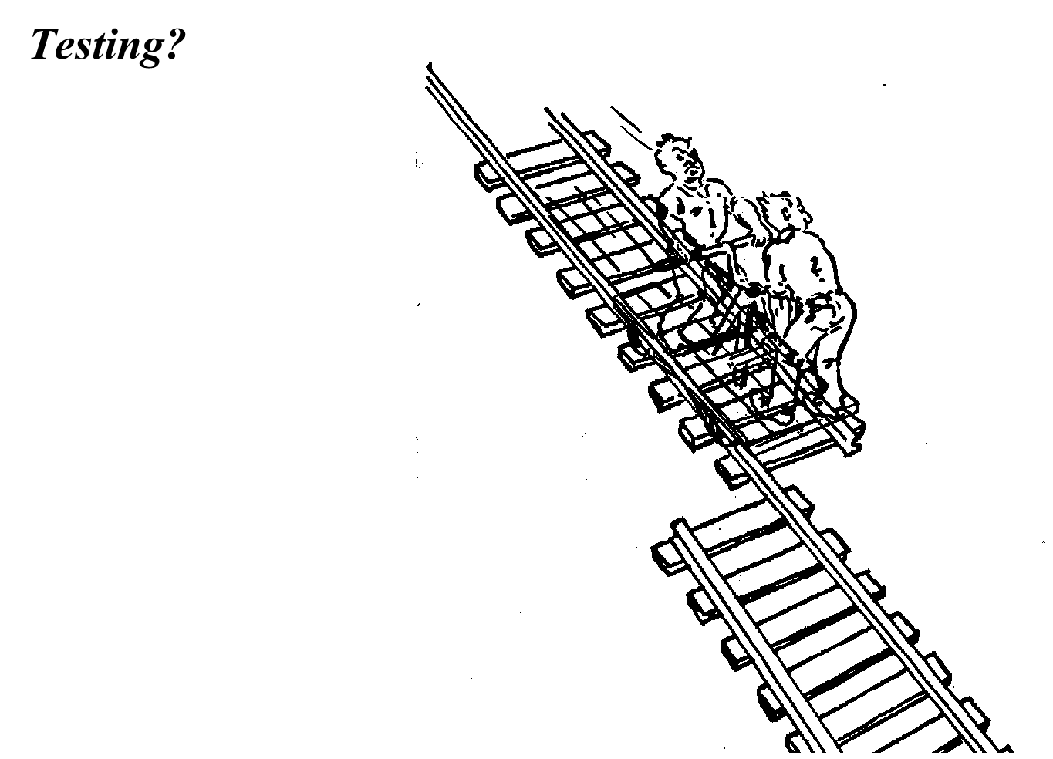

Slide 27
Testing takes creativity
Testing often viewed as dirty work.
To develop an effective test, one must have:
Detailed understanding of the system
Knowledge of the testing techniques
Skill to apply these techniques in an effective and efficient manner
Testing is done best by independent testers
We often develop a certain mental attitude that the program should in a certain way when in fact it does not.
Programmer often stick to the data set that makes the program work
"Don’t mess up my code!"
A program often does not work when tried by somebody else.
Don't let this be the end-user.

Slide 28
Test Cases
Test case 1 : ? (To execute loop exactly once)
Test case 2 : ? (To skip loop body)
Test case 3: ?,? (to execute loop more than once)
These 3 test cases cover all control flow paths

